Slide 1
Identifying and profiling out of school populations – lessons from the UNICEF/UIS Out of School Children Initiative
PISA for Development, Paris, 27-28 June
Albert Motivans, UNESCO Institute for Statistics
Jordan Naidoo, UNICEF

Slide 2
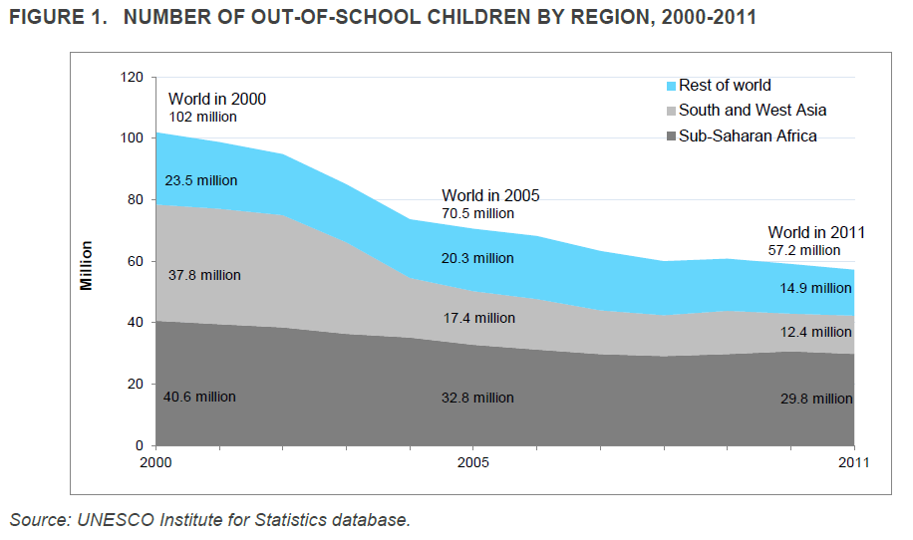
Slowdown in educational progress
Number of primary school-aged children out of school, 2000- 2011
Number

Slide 3
An unfinished education agenda
69 million young adolescents were out of school
31 million out-of-school young adolescents in South and West Asia although there much progress for girls
Sub-Saharan Africa (22 million) has been almost no change in participation rates or gender parity
Little progress in reducing dropout–34 million children left school before reaching the last grade of primary education - an early school leaving rate of 25% – the same level as in 2000.

Slide 4
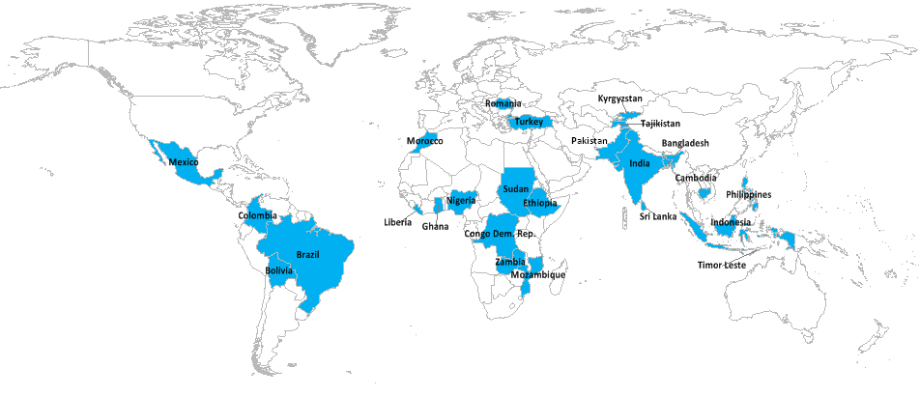
What is the Out of School Children Initiative?
  Objective: To reduce the number of out of school children by addressing gaps in data collection, analysis and policy on out of school children
  - National teams/partners coordinated by UNICEF and UIS
Around half of the world’s OOSC live in these countries
Notes:
4

Slide 5
Three core objectives
Data: Develop comprehensive profiles of excluded children drawing on a range of data sources using innovative measurement approaches
2. Analysis of barriers: Link quantitative data with the socio-cultural barriers and resource-based bottlenecks that create exclusion
3. Implement policies: Identify policies which reduce exclusion from education (especially among groups most disadvantaged) from a multi-sectoral approach
Notes:
5
5

Slide 6
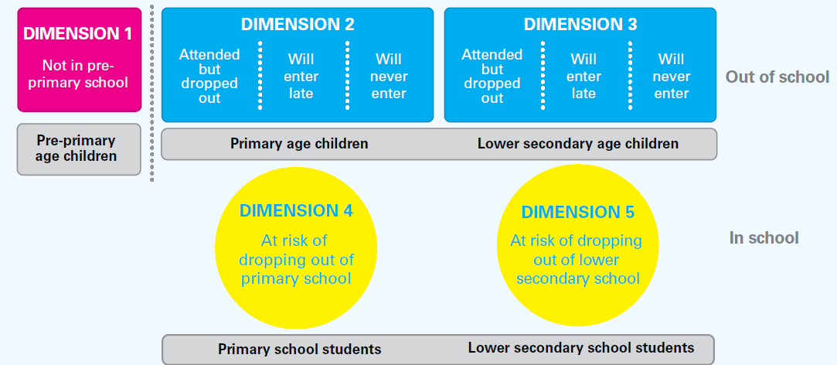
Five dimensions of exclusion model
Data sources: Administrative data/hh-based surveys
Key outputs: OOS Typologies and disaggregated profiles

Slide 7
Problems in identifying age cohorts
Administrative data (supply-side)
  School reporting problematic, capture systems weak
  Often collected in completed years not. DOB
  Age distribution seems to overstate participation in younger ages – and understate (or gets right?) older ages
Household survey data (demand-side)
  Proxy reporting problematic, age-heaping
  Often collected in completed years not. DOB
  Age distribution seems to overstate participation in older ages – understate (or gets right?) younger ages

Slide 8
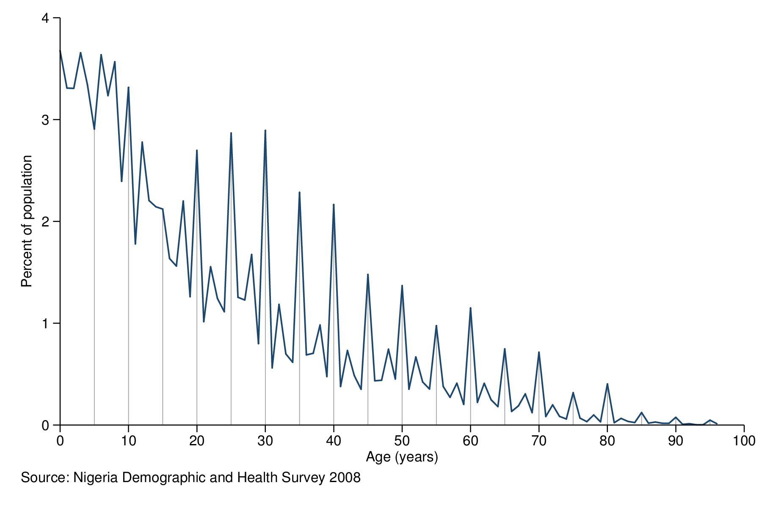
Population distribution by
single year of age Nigeria, 2008

Slide 9
Where are 15 year olds in schools?

Slide 10
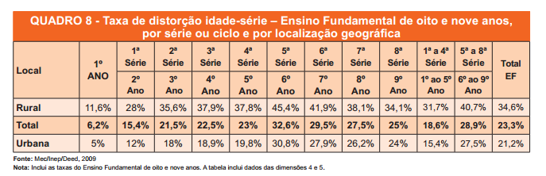
Overage pupils by grade in Brazil
% students who are one or more years over-age
by grade and location, 2009
Source: Brazil OOSCI report http://www.uis.unesco.org/Education/Documents/OOSCI%20Reports/brazil-oosci-report-2012-pr.pdf

Slide 11
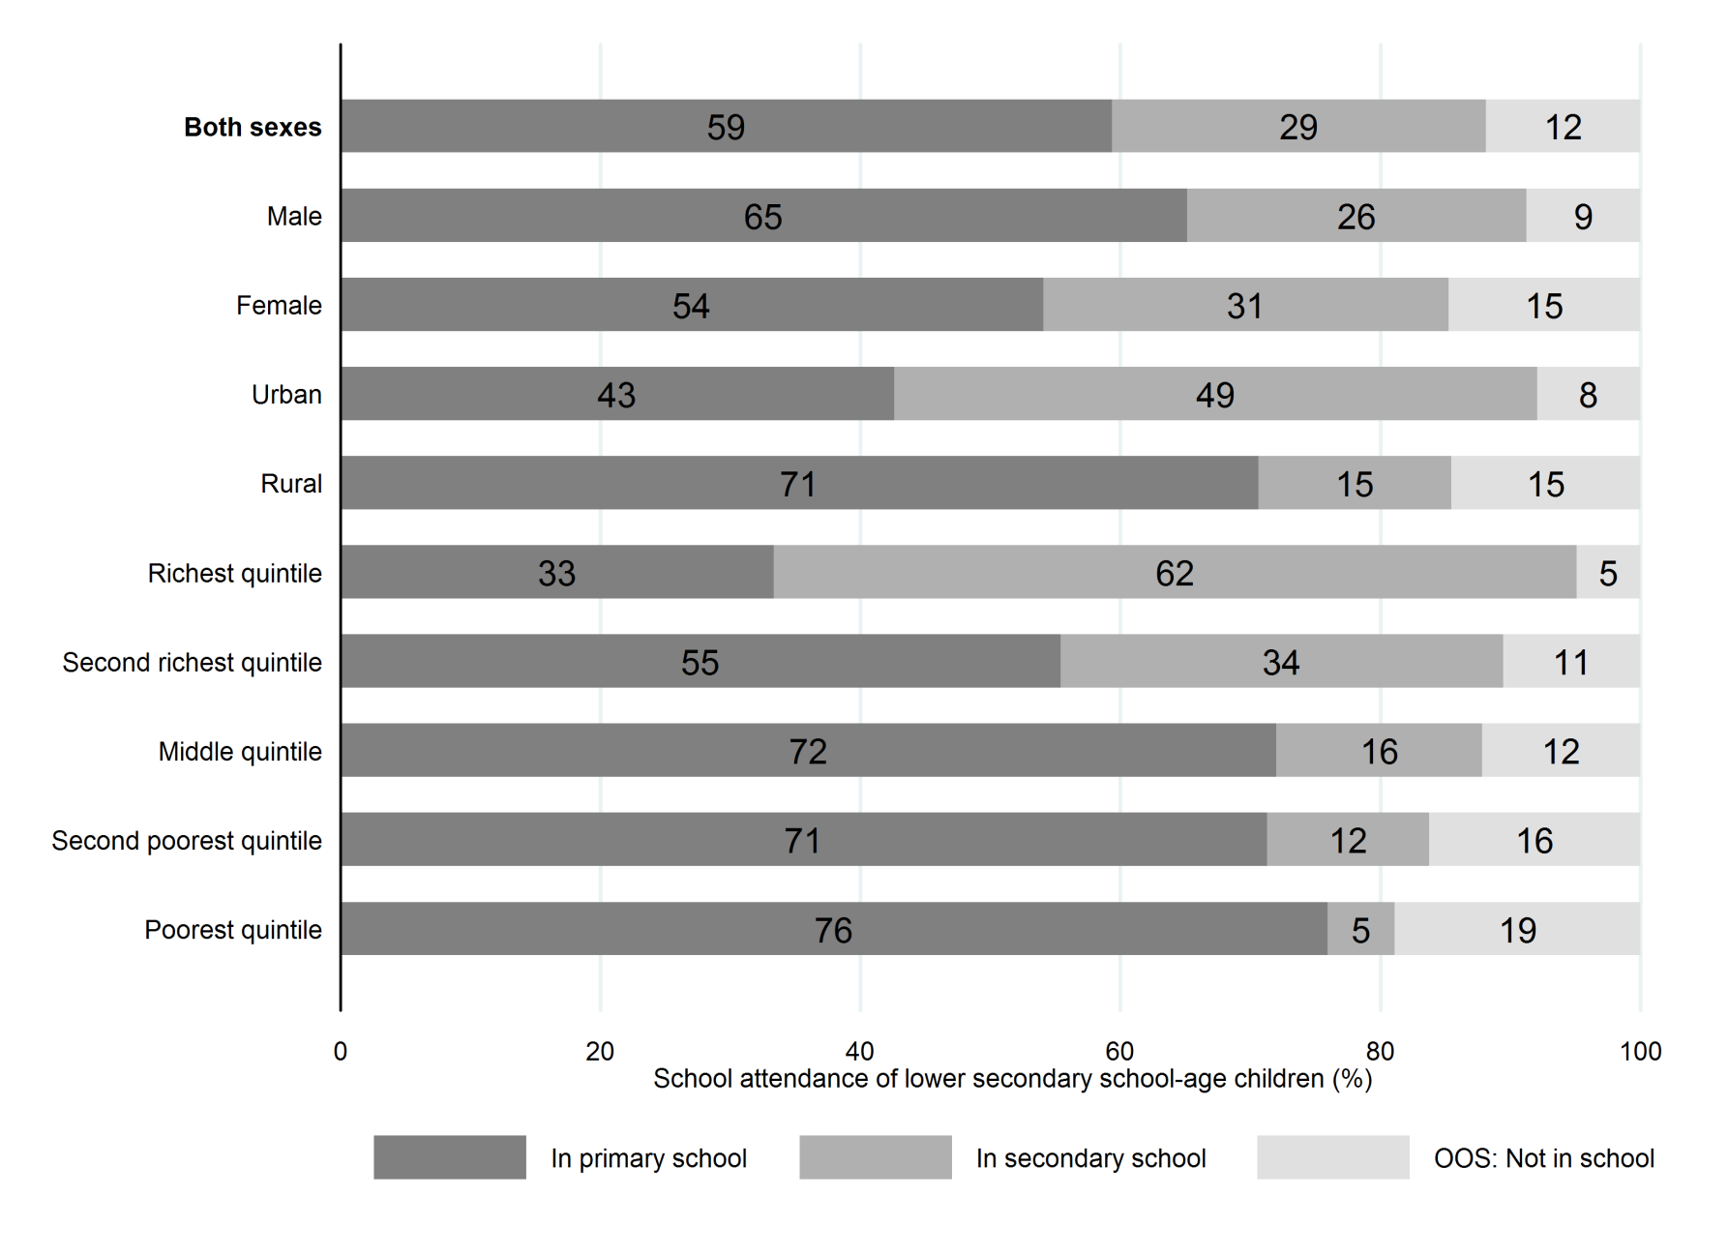
Lower secondary school age students by level attended in Zambia, 2007
Source: UIS calculations based on Zambia DHS 2007

Slide 12
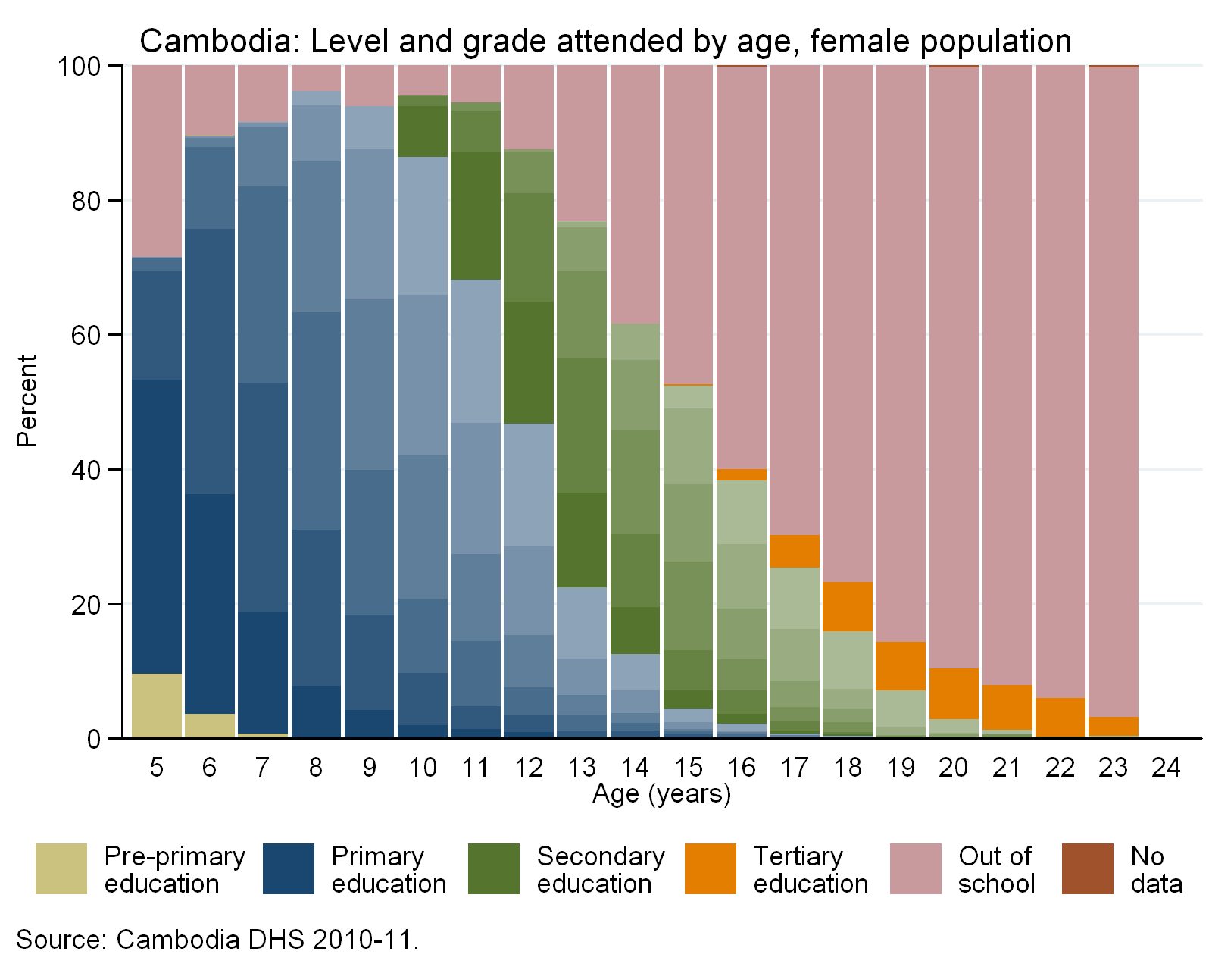
Where are 15 year-old girls in Cambodia?
Source: DHS, Cambodia 2010-11

Slide 13
School attendance by age and household wealth
India 2000
Indonesia 2002-03
Mali 2001
Nigeria 2003

Slide 14
How many and who are out of school?

Slide 15
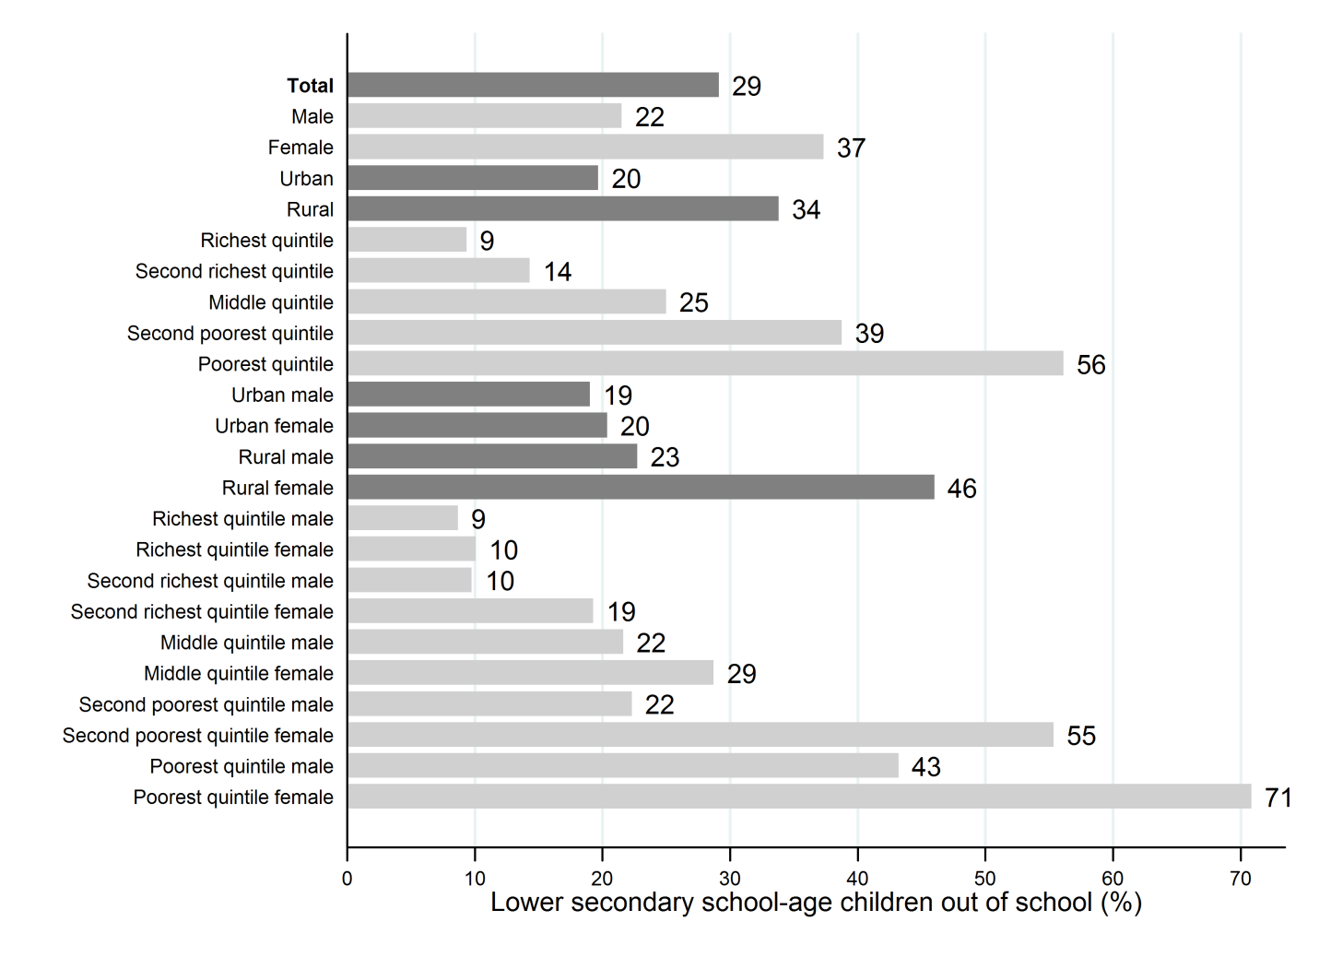
Out-of-school children of lower secondary school age, Pakistan, 2006-07
Source: UIS calculations based on Pakistan DHS 2006-07

Slide 16
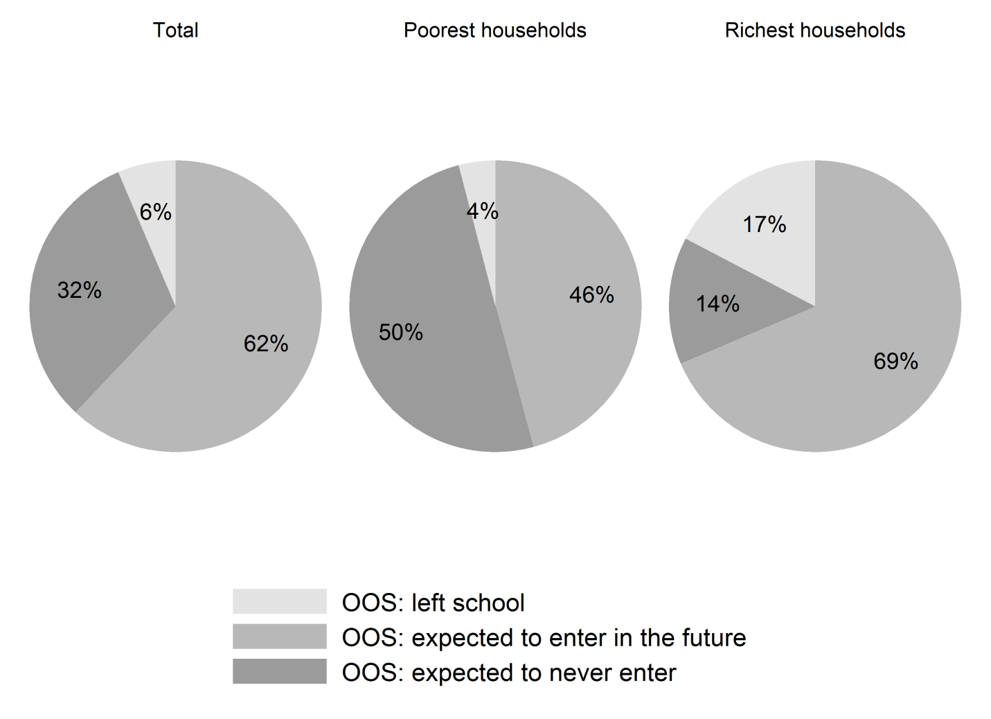
School exposure of out-of-school children, by household wealth in Pakistan, 2006-07
Source: UIS calculations based on Pakistan DHS 2006-07

Slide 17
Out-of-school children from poor households are more likely to never attend school
Nigeria
73
Yemen
45
Ghana
33
Timor-Leste
29
Kenya
23
Liberia
23
DR Congo
15
Cambodia
3
Colombia
1
Brazil
1
Zambia
-2
Kyrgyzstan
-12
Bolivia
-21
-20
0
20
40
60
80
Difference "will never attend" poorest-richest (%)
Source: Household survey data, 2006-2010. Data for children of primary school age.

Slide 18
Considerations
There is potential for using OOSCI results to help design a strategy to reach youth
  In schools (across grades and levels)
  Outside of schools
Disadvantage mediates school progression and out of school status
Recognise technical limitations
  Measuring age is problematic
  Coverage issues (reaching most disadvantaged)
  Use of national data for targeting and profiling is still limited
Sampling strategies
Presenting assessment results
  On-time, late, out of school

